Slide 1
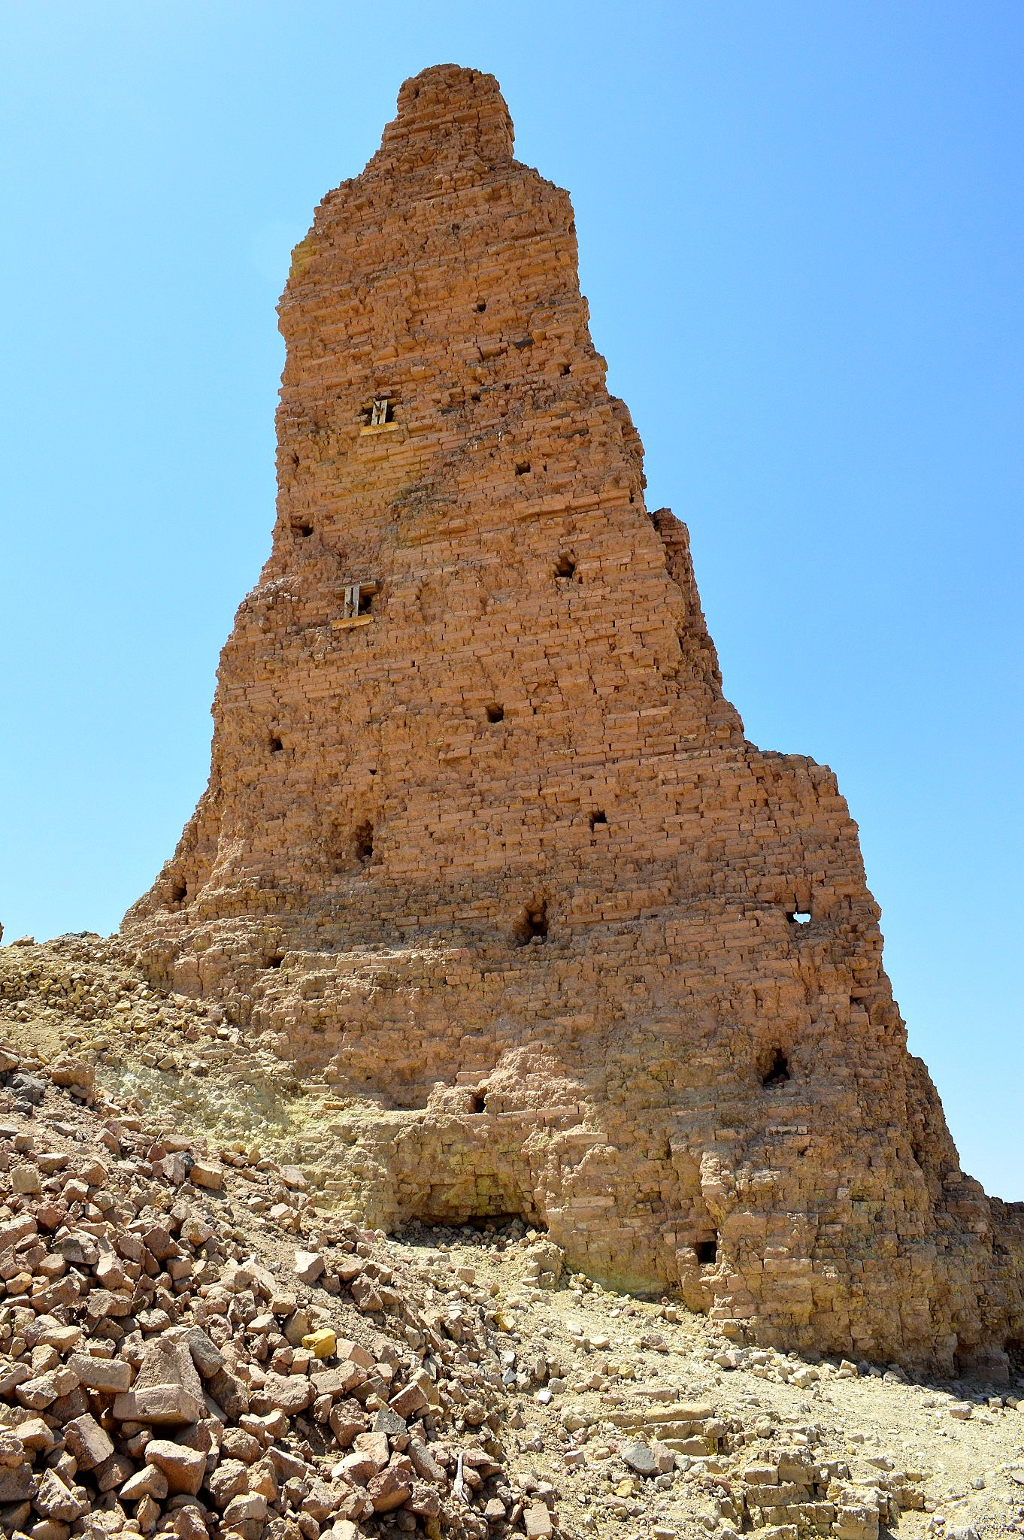
The Towering
EGO

Slide 2
⁸ Now Cush became the father of Nimrod; he became a mighty one on the earth. ⁹ He was a mighty hunter before the LORD; therefore, it is said, "Like Nimrod a mighty hunter before the LORD."¹⁰ The beginning of his kingdom was Babel and Erech and Accad and Calneh, in the land of Shinar. (Gen. 10:8-10)

Slide 3
⁶ The LORD said, "Behold, they are one people, and they all have the same language. And this is what they began to do, and now nothing which they purpose to do will be impossible for them. ⁷ "Come, let Us go down and there confuse their language, so that they will not understand one another's speech." (Gen. 11:6-7)

Slide 4
Lesson #1: Never listen to THEY

Slide 5
Now the whole earth used the same language and the same words. ² It came about as they journeyed east, that they found a plain in the land of Shinar and settled there.

Slide 6
³ They said to one another, "Come, let us make bricks and burn them thoroughly." And they used brick for stone, and they used tar for mortar.

Slide 7
⁴ They said, "Come, let us build for ourselves a city, and a tower whose top will reach into heaven, and let us make for ourselves a name, otherwise we will be scattered abroad over the face of the whole earth." (Gen. 11:1-4)

Slide 8
The most effective poison to lead men to ruin is to boast in themselves, in their own wisdom and will power. – John Calvin

Slide 9
Lesson #2: Pride turns ANGELS into DEVILS
⁴ They said, "Come, let us build for ourselves a city, and a tower whose top will reach into heaven, and let us make for ourselves a name

Slide 10
“Human beings act differently when they are alone than when there are in the presence of someone else. As humans we are usually aware of how others expect us to act. So, we end up accommodating others by acting as we know they expect us to act. That’s why all of our housing subdivisions look the same, that’s why everyone in a certain generation pretty much dress alike.” – John Paul Sartre

Slide 11
'Thus says the Lord GOD, "You had the seal of perfection, Full of wisdom and perfect in beauty. ¹³ "You were in Eden, the garden of God; Every precious stone was your covering: ...¹⁴ "You were the anointed cherub who covers, And I placed you there. You were on the holy mountain of God...¹⁵ "You were blameless in your ways from the day you were created until unrighteousness was found in you. (Ezek. 28:12-15)

Slide 12
¹² "How you have fallen from heaven, O star of the morning, son of the dawn! You have been cut down to the earth, You who have weakened the nations! ¹³ "But you said in your heart, 'I will ascend to heaven; I will raise my throne above the stars of God, And I will sit on the mount of assembly In the recesses of the north.¹⁴ 'I will ascend above the heights of the clouds; I will make myself like the Most High.' (Isa. 14:12-14)

Slide 13
Lesson #3: God is not curious, He is judge

Slide 14
The LORD came down to see the city and the tower which the sons of men had built. The LORD said, "Behold, they are one people, and they all have the same language.

Slide 15
And this is what they began to do, and now nothing which they purpose to do will be impossible for them. "Come, let Us go down and there confuse their language, so that they will not understand one another's speech." (Gen. 11:5-7)

Slide 16
4. God’s Ultimate Work is to Restore what is Lost

Slide 17
"Come, let Us go down and there confuse their language, so that they will not understand one another's speech." So the LORD scattered them abroad from there over the face of the whole earth; and they stopped building the city. (Gen. 11:7-8)

Slide 18
And suddenly there came from heaven a noise like a violent rushing wind, and it filled the whole house where they were sitting. And there appeared to them tongues as of fire distributing themselves, and they rested on each one of them. And they were all filled with the Holy Spirit and began to speak with other tongues, as the Spirit was giving them utterance. (Acts 2:1-4)

Slide 19
⁴ And they were all filled with the Holy Spirit and began to speak with other tongues, as the Spirit was giving them utterance. ⁵ Now there were Jews living in Jerusalem, devout men from every nation under heaven.

Slide 20
⁶ And when this sound occurred, the crowd came together, and were bewildered because each one of them was hearing them speak in his own language.⁷ They were amazed and astonished, saying, "Why, are not all these who are speaking Galileans?

Slide 21
⁸ "And how is it that we each hear them in our own language to which we were born? ⁹ "Parthians and Medes and Elamites, and residents of Mesopotamia, Judea and Cappadocia, Pontus and Asia,

Slide 22
¹⁰ Phrygia and Pamphylia, Egypt and the districts of Libya around Cyrene, and visitors from Rome, both Jews and proselytes, ¹¹ Cretans and Arabs-- we hear them in our own tongues speaking of the mighty deeds of God."

Slide 23
¹² And they all continued in amazement and great perplexity, saying to one another, "What does this mean?" ¹³ But others were mocking and saying, "They are full of sweet wine."(Acts 2:4-13)

Slide 24
¹⁴ But Peter, taking his stand with the eleven, raised his voice and declared to them: "Men of Judea and all you who live in Jerusalem, let this be known to you and give heed to my words.¹⁵ "For these men are not drunk, as you suppose, for it is only the third hour of the day;

Slide 25
¹⁶ but this is what was spoken of through the prophet Joel: ¹⁷ 'AND IT SHALL BE IN THE LAST DAYS,' God says, 'THAT I WILL POUR FORTH OF MY SPIRIT ON ALL MANKIND ... ²¹ 'AND IT SHALL BE THAT EVERYONE WHO CALLS ON THE NAME OF THE LORD WILL BE SAVED.' (Acts 2:14-17, 21)

Slide 26
When the record of guilt is gone, what guilt had stolen, grace at once restores.

Slide 27
The Eternal
STORY

