Slide 1
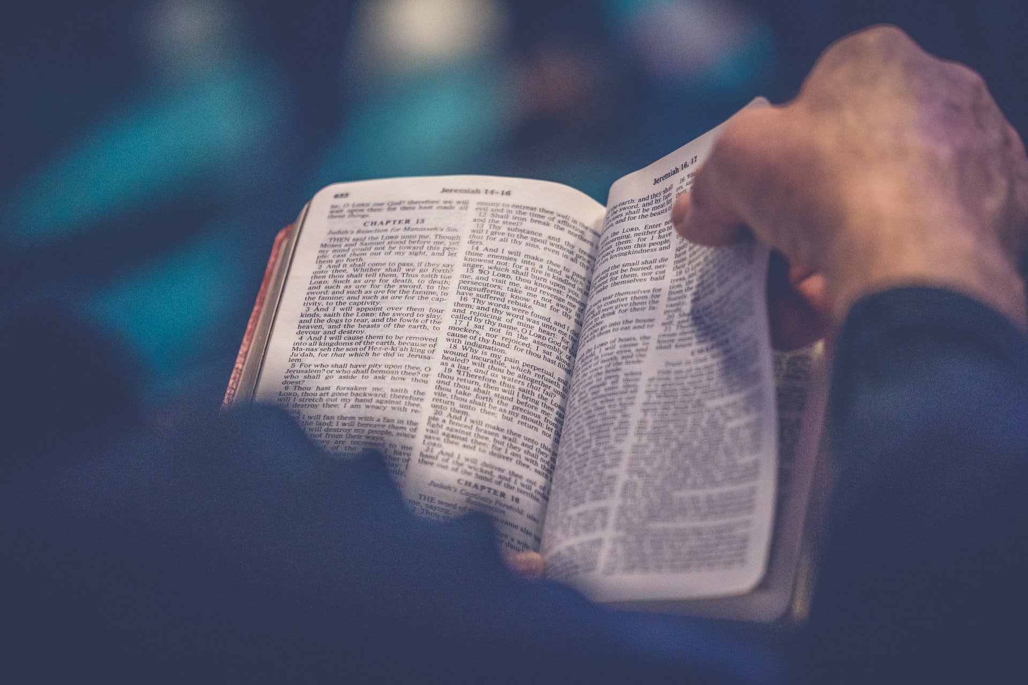
Not By The Will of Man

Slide 2
Evangelism only seems difficult or impossible in certain situations if we think the will of man plays some role in salvation.

Slide 3
But the natural man does not accept the things of the Spirit of God, for they are foolishness to him; and he cannot understand them, because they are spiritually appraised. (1 Cor. 2:10-14)

Slide 4
1. The New Testament BUILDS upon and illuminates everything we read in the Old Testament.

Slide 5
¹⁴ What shall we say then? There is no injustice with God, is there? May it never be! ¹⁵ For He says to Moses, "I WILL HAVE MERCY ON WHOM I HAVE MERCY, AND I WILL HAVE COMPASSION ON WHOM I HAVE COMPASSION."

Slide 6
¹⁶ So then it does not depend on the man who wills or the man who runs, but on God who has mercy.

Slide 7
¹⁷ For the Scripture says to Pharaoh, "FOR THIS VERY PURPOSE I RAISED YOU UP, TO DEMONSTRATE MY POWER IN YOU, AND THAT MY NAME MIGHT BE PROCLAIMED THROUGHOUT THE WHOLE EARTH." ¹⁸ So then He has mercy on whom He desires, and He hardens whom He desires. (Rom. 9:14-18)

Slide 8
God decides who will rebel in the hardness of their unbelief and they will deservingly be condemned. The hardening of God does not make their fault impossible; it makes their fault certain. – Charles Spurgeon

Slide 9
The words in this scripture are clear, simple, and plain.
The paralleling of mercy with hardening illustrates that the works of God are both unconditional and just.
Paul foresees our natural objection to God having absolute control over both mercy and hardening and therefore challenges us with God breathed logic.

Slide 10
... who are you, O man, who answers back to God? The thing molded will not say to the molder, "Why did you make me like this," will it? ²¹ Or does not the potter have a right over the clay, to make from the same lump one vessel for honorable use and another for common use? (Rom. 9:20-21)

Slide 11
2. Nowhere Does the Bible Say God Hardens Anyone Who Had Not First Hardened Themselves.

Slide 12
¹⁰ So Moses and Aaron came to Pharaoh, and thus they did just as the LORD had commanded; and Aaron threw his staff down before Pharaoh and his servants, and it became a serpent. ¹¹ Then Pharaoh also called for the wise men and the sorcerers, and they also, the magicians of Egypt, did the same with their secret arts.

Slide 13
¹² For each one threw down his staff and they turned into serpents. But Aaron's staff swallowed up their staffs. ¹³ Yet Pharaoh's heart was hardened, and he did not listen to them, as the LORD had said. ¹⁴ Then the LORD said to Moses, "Pharaoh's heart is stubborn; he refuses to let the people go. (Exod. 7:10-14)

Slide 14
and Pharaoh's heart was hardened, and he did not listen to them, as the LORD had said. (Exod. 7:22)
But when Pharaoh saw that there was relief, he hardened his heart and did not listen to them, as the LORD had said. (Exod. 8:15)
But Pharaoh's heart was hardened, and he did not listen to them, as the LORD had said. (Exod. 8:19)

Slide 15
And the LORD hardened Pharaoh's heart, and he did not listen to them, just as the LORD had spoken to Moses. (Exod. 9:12)
And just as they did not see fit to acknowledge God any longer, God gave them over to a depraved mind, to do those things which are not proper, (Rom. 1:28)

Slide 16
3. God’s Glory & Name Calls Us To Evangelism
For the Scripture says to Pharaoh, "FOR THIS VERY PURPOSE, I RAISED YOU UP, TO DEMONSTRATE MY POWER IN YOU, AND THAT MY NAME MIGHT BE PROCLAIMED THROUGHOUT THE WHOLE EARTH." (Rom. 9:17)

Slide 17
For Christ did not send me to baptize, but to preach the gospel, (1 Cor. 1:17)

Slide 18
And when I came to you, brethren, I did not come with superiority of speech or of wisdom, proclaiming to you the testimony of God. For I determined to know nothing among you except Jesus Christ, and Him crucified. (1 Cor. 2:1-2)

Slide 19
The message of God’s Righteousness and Man’s Sin
The message of Christ’s redemptive work
The call to faith and repentance

Slide 20
The Spirit and the bride say, "Come." And let the one who hears say, "Come." And let the one who is thirsty come; let the one who wishes take the water of life without cost. (Rev. 22:17)

