Slide 1

Christ Our Passover Lamb
Exodus 12
The Church That Pleases God

Slide 2
Trusting God
Now the LORD said to Moses and Aaron in the land of Egypt, ² "This month shall be the beginning of months for you; it is to be the first month of the year to you.
Casting Seed
The Church That Pleases God

Slide 3
Trusting God
³ "Speak to all the congregation of Israel, saying, 'On the tenth of this month they are each one to take a lamb for themselves, according to their fathers' households, a lamb for each household.
Casting Seed
The Church That Pleases God

Slide 4
Trusting God
⁴ 'Now if the household is too small for a lamb, then he and his neighbor nearest to his house are to take one according to the number of persons in them; according to what each man should eat, you are to divide the lamb.
Casting Seed
The Church That Pleases God

Slide 5
Trusting God
⁵ 'Your lamb shall be an unblemished male a year old; you may take it from the sheep or from the goats. ⁶ 'You shall keep it until the fourteenth day of the same month, then the whole assembly of the congregation of Israel is to kill it at twilight. (Exodus 12:1-6)
Casting Seed
The Church That Pleases God

Slide 6
Trusting God
'Now you shall eat it in this manner: with your loins girded, your sandals on your feet, and your staff in your hand; and you shall eat it in haste-- it is the LORD'S Passover. (Exodus 12:11)
Casting Seed
The Church That Pleases God

Slide 7
Trusting God
'Your lamb shall be an unblemished male a year old”
The Passover Lamb was Perfect
Casting Seed
The Church That Pleases God

Slide 8
Trusting God
... “you may take it from the sheep or from the goats. 'You shall keep it until the fourteenth day of the same month”
2. The Passover Lamb was Proven
Casting Seed
The Church That Pleases God

Slide 9
Trusting God
For Christ our Passover also has been sacrificed. Therefore, let us celebrate the feast, not with old leaven, nor with the leaven of malice and wickedness, but with the unleavened bread of sincerity and truth. (1 Cor. 5:7-8)
3. The Passover Lamb Satisfies
Casting Seed
The Church That Pleases God

Slide 10
Trusting God
⁷ 'Moreover, they shall take some of the blood and put it on the two doorposts and on the lintel of the houses in which they eat it. ⁸'They shall eat the flesh that same night, roasted with fire, and they shall eat it with unleavened bread and bitter herbs
Casting Seed
The Church That Pleases God

Slide 11
Trusting God
⁹ 'Do not eat any of it raw or boiled at all with water, but rather roasted with fire, both its head and its legs along with its entrails. ¹⁰ 'And you shall not leave any of it over until morning, but whatever is left of it until morning, you shall burn with fire. (Exodus 12:8-10)
Casting Seed
The Church That Pleases God

Slide 12
Trusting God
Peter, an apostle of Jesus Christ, To those who reside as aliens, scattered throughout Pontus, Galatia, Cappadocia, Asia, and Bithynia, who are chosen according to the foreknowledge of God the Father, by the sanctifying work of the Spirit, to obey Jesus Christ and be sprinkled with His blood: (1 Pet. 1:1-2)
Casting Seed
The Church That Pleases God

Slide 13
Trusting God
For it was the Father's good pleasure for all the fullness to dwell in Him, and through Him to reconcile all things to Himself, having made peace through the blood of His cross; through Him, (Col. 1:19-20)
Casting Seed
The Church That Pleases God

Slide 14
Trusting God
God willed to make known what is the riches of the glory of this mystery among the Gentiles, which is Christ in you, the hope of glory. (Col. 1:26-27)
Casting Seed
The Church That Pleases God

Slide 15
Trusting God
Jesus said to them, "I am the bread of life; he who comes to Me will not hunger, and he who believes in Me will never thirst. (Jn. 6:35)
For He has satisfied the thirsty soul, And the hungry soul He has filled with what is good. (Ps. 107:9)
Casting Seed
The Church That Pleases God

Slide 16
Trusting God
'The blood shall be a sign for you on the houses where you live; and when I see the blood, I will pass over you” (Exod. 12:13)
4. There is Safety in the Passover Lamb
Casting Seed
The Church That Pleases God

Slide 17
Trusting God
Save me, LORD, from my enemies; I flee to You to hide me.
(Psalm 143:9)
Casting Seed
The Church That Pleases God

Slide 18
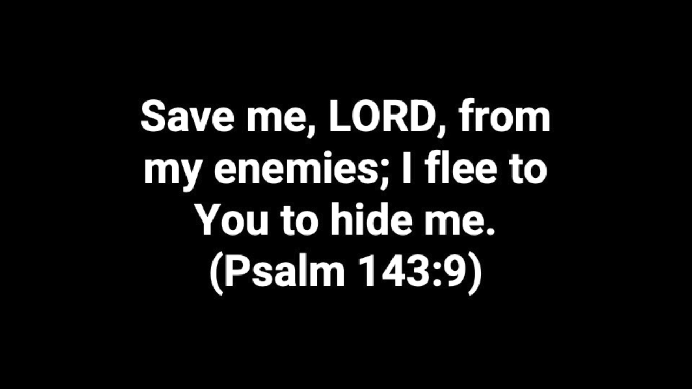

Slide 19
Trusting God
Casting Seed
The Church That Pleases God

