Slide 1
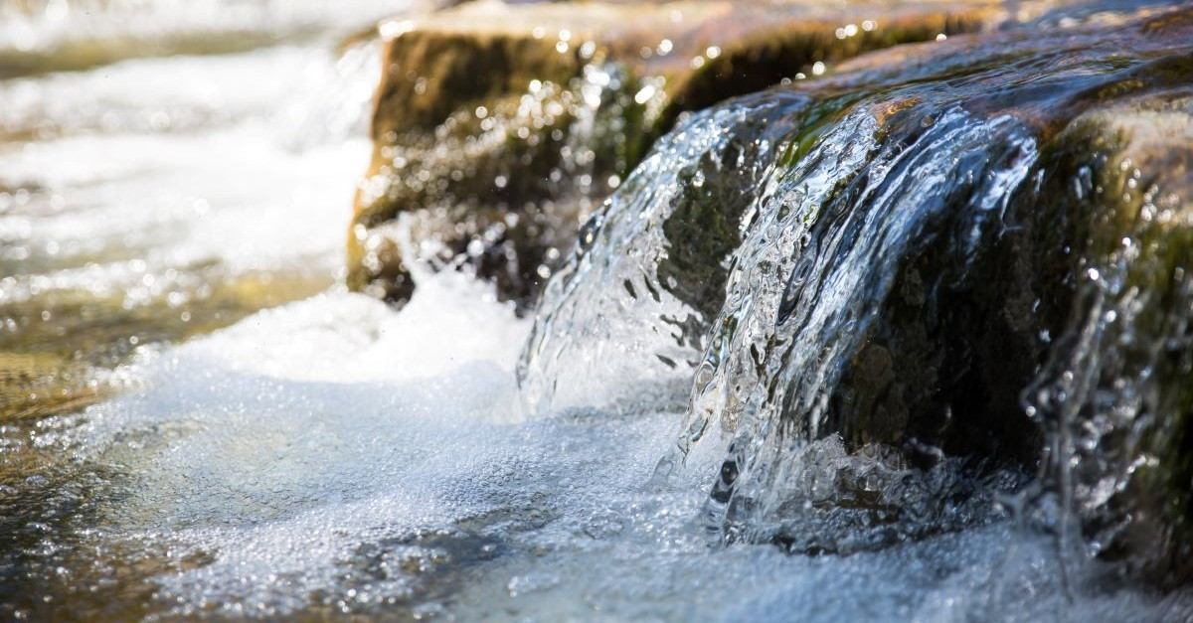
If You Must Fight
Casting Seed
The Church That Pleases God

Slide 2
If You Must Fight
Then Amalek came and fought against Israel at Rephidim. So, Moses said to Joshua, "Choose men for us and go out, fight against Amalek. Tomorrow I will station myself on the top of the hill with the staff of God in my hand." (Exod. 17:8-9)
Casting Seed
The Church That Pleases God

Slide 3
If You Must Fight
¹⁰ Joshua did as Moses told him, and fought against Amalek; and Moses, Aaron, and Hur went up to the top of the hill. ¹¹ So it came about when Moses held his hand up, that Israel prevailed, and when he let his hand down, Amalek prevailed.
Casting Seed
The Church That Pleases God

Slide 4
If You Must Fight
¹² But Moses' hands were heavy. Then they took a stone and put it under him, and he sat on it; and Aaron and Hur supported his hands, one on one side and one on the other. Thus, his hands were steady until the sun set.)
Casting Seed
The Church That Pleases God

Slide 5
If You Must Fight
¹³ So Joshua overwhelmed Amalek and his people with the edge of the sword.
Casting Seed
The Church That Pleases God

Slide 6
If You Must Fight
¹⁴ Then the LORD said to Moses, "Write this in a book as a memorial and recite it to Joshua, that I will utterly blot out the memory of Amalek from under heaven." ¹⁵ Moses built an altar and named it The LORD is My Banner; (Exod. 17:10-15)
Casting Seed
The Church That Pleases God

Slide 7
If You Must Fight
The War Must Be HOLY
Casting Seed
The Church That Pleases God

Slide 8
If You Must Fight
2. Our Weapons are Godly
Casting Seed
The Church That Pleases God

Slide 9
Trusting God
C. H. MacIntosh “Let us bear in mind that where the Holy Ghost is working, one instrument is as good and as efficient as seventy; and where He is not working, seventy are of no more value than one.”
Casting Seed
The Church That Pleases God

Slide 10
Trusting God
Perplexing Paths
Casting Seed

Slide 11
Trusting God
"God will surely take care of you, and you shall carry my bones from here with you." ²⁰ Then they set out from Succoth and camped in Etham on the edge of the wilderness.
Casting Seed
The Church That Pleases God

Slide 12
Trusting God
²¹ The LORD was going before them in a pillar of cloud by day to lead them on the way, and in a pillar of fire by night to give them light, that they might travel by day and by night. (Exod. 13:17-21)
Casting Seed
The Church That Pleases God

Slide 13
Trusting God
2. Disturbing Dead-Ends
Casting Seed
The Church That Pleases God

Slide 14
Trusting God
⁴ "Thus I will harden Pharaoh's heart, and he will chase after them; and I will be honored through Pharaoh and all his army, and the Egyptians will know that I am the LORD." And they did so.
Casting Seed
The Church That Pleases God

Slide 15
Trusting God
⁵ When the king of Egypt was told that the people had fled, Pharaoh and his servants had a change of heart toward the people, and they said, "What is this we have done, that we have let Israel go from serving us?"
Casting Seed
The Church That Pleases God

Slide 16
Trusting God
⁶ So he made his chariot ready and took his people with him; ⁷ and he took six hundred select chariots, and all the other chariots of Egypt with officers over all of them. ⁸ The LORD hardened the heart of Pharaoh, king of Egypt, and he chased after the sons of Israel as the sons of Israel were going out boldly.
Casting Seed
The Church That Pleases God

Slide 17
Trusting God
⁹ Then the Egyptians chased after them with all the horses and chariots of Pharaoh, his horsemen and his army, and they overtook them camping by the sea, beside Pi-hahiroth, in front of Baal-zephon.
Casting Seed
The Church That Pleases God

Slide 18
Trusting God
¹⁰ As Pharaoh drew near, the sons of Israel looked, and behold, the Egyptians were marching after them, and they became very frightened; so the sons of Israel cried out to the LORD.
Casting Seed
The Church That Pleases God

Slide 19
Trusting God
¹¹ Then they said to Moses, "Is it because there were no graves in Egypt that you have taken us away to die in the wilderness? Why have you dealt with us in this way, bringing us out of Egypt?
Casting Seed
The Church That Pleases God

Slide 20
Trusting God
¹² "Is this not the word that we spoke to you in Egypt, saying, 'Leave us alone that we may serve the Egyptians '? For it would have been better for us to serve the Egyptians than to die in the wilderness."
Casting Seed
The Church That Pleases God

Slide 21
Trusting God
¹³ But Moses said to the people, "Do not fear! Stand by and see the salvation of the LORD which He will accomplish for you today; for the Egyptians whom you have seen today, you will never see them again forever.
Casting Seed
The Church That Pleases God

Slide 22
Trusting God
¹⁴ "The LORD will fight for you while you keep silent." ¹⁵ Then the LORD said to Moses, "Why are you crying out to Me? Tell the sons of Israel to go forward. (Exod. 14:5-15)
Casting Seed
The Church That Pleases God

Slide 23
Trusting God
Do not fear! Stand by
See the Salvation of the Lord
Go forward
Casting Seed
The Church That Pleases God

Slide 24
Trusting God
²¹ Then Moses stretched out his hand over the sea; and the LORD swept the sea back by a strong east wind all night and turned the sea into dry land, so the waters were divided.
Casting Seed
The Church That Pleases God

Slide 25
Trusting God
²² The sons of Israel went through the midst of the sea on the dry land, and the waters were like a wall to them on their right hand and on their left. ²³ Then the Egyptians took up the pursuit, and all Pharaoh's horses, his chariots and his horsemen went in after them into the midst of the sea.
Casting Seed
The Church That Pleases God

Slide 26
Trusting God
²⁴ At the morning watch, the LORD looked down on the army of the Egyptians through the pillar of fire and cloud and brought the army of the Egyptians into confusion.
Casting Seed
The Church That Pleases God

Slide 27
Trusting God
²⁵ He caused their chariot wheels to swerve, and He made them drive with difficulty; so the Egyptians said, "Let us flee from Israel, for the LORD is fighting for them against the Egyptians."
Casting Seed
The Church That Pleases God

Slide 28
Trusting God
²⁶ Then the LORD said to Moses, "Stretch out your hand over the sea so that the waters may come back over the Egyptians, over their chariots and their horsemen."
Casting Seed
The Church That Pleases God

Slide 29
Trusting God
²⁷ So Moses stretched out his hand over the sea, and the sea returned to its normal state at daybreak, while the Egyptians were fleeing right into it; then the LORD overthrew the Egyptians in the midst of the sea.
Casting Seed
The Church That Pleases God

Slide 30
Trusting God
²⁸ The waters returned and covered the chariots and the horsemen, even Pharaoh's entire army that had gone into the sea after them; not even one of them remained. ²⁹ But the sons of Israel walked on dry land through the midst of the sea, and the waters were like a wall to them on their right hand and on their left.
Casting Seed
The Church That Pleases God

Slide 31
Trusting God
³⁰ Thus the LORD saved Israel that day from the hand of the Egyptians, and Israel saw the Egyptians dead on the seashore.
Casting Seed
The Church That Pleases God

Slide 32
Trusting God
³¹ When Israel saw the great power which the LORD had used against the Egyptians, the people feared the LORD, and they believed in the LORD and in His servant Moses. (Exod. 14:21-31)
Casting Seed
The Church That Pleases God

Slide 33
Trusting God
Consider it all joy, my brethren, when you encounter various trials, knowing that the testing of your faith produces endurance. And let endurance have its perfect result, so that you may be perfect and complete, lacking in nothing. (James 1:2-4)
Casting Seed
The Church That Pleases God

Slide 34
Trusting God
3. Bitter Realities
Casting Seed
The Church That Pleases God

Slide 35
Trusting God
²² Then Moses led Israel from the Red Sea, and they went out into the wilderness of Shur; and they went three days in the wilderness and found no water.
Casting Seed
The Church That Pleases God

Slide 36
Trusting God
²³ When they came to Marah, they could not drink the waters of Marah, for they were bitter; therefore, it was named Marah. ²⁴ So the people grumbled at Moses, saying, "What shall we drink?"
Casting Seed
The Church That Pleases God

Slide 37
Trusting God
²⁵ Then he cried out to the LORD, and the LORD showed him a tree; and he threw it into the waters, and the waters became sweet. There He made for them a statute and regulation, and there He tested them. (Exod. 15:22-25)
Casting Seed
The Church That Pleases God

Slide 38
Trusting God
The LORD hears your grumblings which you grumble against Him. And what are we? Your grumblings are not against us but against the LORD." (Exod. 16:8)
Casting Seed
The Church That Pleases God

Slide 39
Trusting God
So, the people grumbled at Moses, saying, "What shall we drink?" Then he cried out to the LORD
Casting Seed
The Church That Pleases God

Slide 40
Trusting God
... the LORD showed him a tree; and he threw it into the waters, and the waters became sweet.
Casting Seed
The Church That Pleases God

Slide 41
Trusting God
²⁷ Then they came to Elim where there were twelve springs of water and seventy date palms, and they camped there beside the waters. (Exodus 15:27)
Casting Seed
The Church That Pleases God

Slide 42
Trusting God
Lord I would clasp thy hand in mine; nor ever murmur or repine Content whatever lot I see; Since tis thy hand that leadeth me.
Casting Seed
The Church That Pleases God

Slide 43
Trusting God
Prone to wander, Lord, I feel it, Prone to leave the God I love Here's my heart, oh take and seal it, Seal it for Thy courts above
Casting Seed
The Church That Pleases God

Slide 44
Trusting God
Casting Seed
The Church That Pleases God

