Slide 1
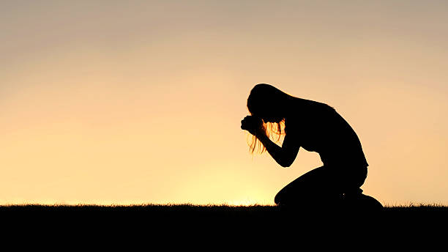
The Power of Returning
Genesis 34 & 35

Slide 2
³⁰ Then Jacob said to Simeon and Levi, "You have brought trouble on me by making me odious among the inhabitants of the land, among the Canaanites and the Perizzites; and my men being few in number, they will gather together against me and attack me, and I will be destroyed, I and my household." ³¹ But they said, "Should he treat our sister as a harlot?" (Gen. 34:30-31)

Slide 3
Then God said to Jacob, "Arise, go up to Bethel and live there, and make an altar there to God, who appeared to you when you fled from your brother Esau." (Gen. 35:1)
1. There is an invitation to answer

Slide 4
Spiritual complacency is the consequence of not abiding.
1. There is an invitation to answer

Slide 5
So, Jacob said to his household and to all who were with him, "Put away the foreign gods which are among you and purify yourselves and change your garments; and let us arise and go up to Bethel, and I will make an altar there to God, who answered me in the day of my distress and has been with me wherever I have gone."
1. There is an invitation to answer

Slide 6
So, they gave to Jacob all the foreign gods which they had and the rings which were in their ears, and Jacob hid them under the oak which was near Shechem. (Gen. 35:2-4)
2. There is a determination to make.

Slide 8
As they journeyed, there was a great terror upon the cities which were around them, and they did not pursue the sons of Jacob. (Gen. 35:5)
3. Our God preserves His people

Slide 9
God is fearful
3. Our God preserves His people

Slide 10
⁶ So Jacob came to Luz (that is, Bethel), which is in the land of Canaan, he and all the people who were with him. ⁷ He built an altar there, and called the place El-bethel, because there God had revealed Himself to him when he fled from his brother. (Gen. 35:6-7)
3. Our God preserves His people

Slide 11
God is fearful
God is a person
3. Our God preserves His people

Slide 12
¹¹ God also said to him, "I am God Almighty; Be fruitful and multiply; A nation and a company of nations shall come from you, And kings shall come forth from you. ¹² "The land which I gave to Abraham and Isaac, I will give it to you, And I will give the land to your descendants after you." (Gen. 35:11-12)
3. Our God preserves His people

Slide 13
God is fearful
God is a person
God is a promise-keeper
3. Our God preserves His people

Slide 14
¹⁴ Jacob set up a pillar in the place where He had spoken with him, a pillar of stone, and he poured out a drink offering on it; he also poured oil on it. (Gen. 35:14)
3. Our God preserves His people

Slide 15
The drink offering pictures a: Life poured out
¹⁷ But even if I am being poured out as a drink offering upon the sacrifice and service of your faith, I rejoice and share my joy with you all. (Phil. 2:17)

Slide 16
“Upon the sacrifice of the Lord Jesus Christ I am pouring out my life!”

