Slide 1

The Eternal
STORY

Slide 2
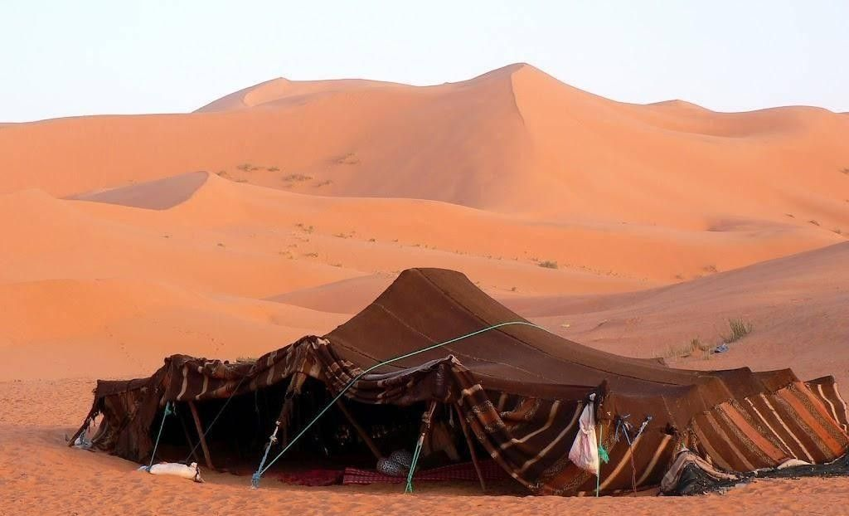
The Troubled
FAMILY

Slide 3
1. Esau despised the birthright, so God rejected him.

Slide 4
²⁸ Now Isaac loved Esau, because he had a taste for game, but Rebekah loved Jacob. ²⁹ When Jacob had cooked stew, Esau came in from the field and he was famished;

Slide 5
³⁰ and Esau said to Jacob, "Please let me have a swallow of that red stuff there, for I am famished." Therefore, his name was called Edom.

Slide 6
But Jacob said, "First sell me your birthright." ³² Esau said, "Behold, I am about to die; so of what use then is the birthright to me?"

Slide 7
³³ And Jacob said, "First swear to me"; so he swore to him, and sold his birthright to Jacob. ³⁴ Then Jacob gave Esau bread and lentil stew; and he ate and drank and rose and went on his way. Thus Esau despised his birthright. (Gen. 25:28-34)

Slide 8
2. Divided parents produce adversarial children

Slide 9
Now it came about, when Isaac was old and his eyes were too dim to see, that he called his older son Esau and said to him, "My son." And he said to him, "Here I am.” Isaac said, "Behold now, I am old, and I do not know the day of my death. (Gen 27:1,2)

Slide 10
³"Now then, please take your gear, your quiver and your bow, and go out to the field and hunt game for me; ⁴ and prepare a savory dish for me such as I love, and bring it to me that I may eat, so that my soul may bless you before I die.”

Slide 11
⁵ Rebekah was listening while Isaac spoke to his son Esau. So when Esau went to the field to hunt for game to bring home, (Gen 27:3-5)

Slide 12
⁶ Rebekah said to her son Jacob, "Behold, I heard your father speak to your brother Esau, saying, ⁷ 'Bring me some game and prepare a savory dish for me,

Slide 13
that I may eat, and bless you in the presence of the LORD before my death.' ⁸ "Now therefore, my son, listen to me as I command you. (Gen 27:6-8)

Slide 14
(Gen 27:9-10) "Go now to the flock and bring me two choice young goats from there, that I may prepare them as a savory dish for your father, such as he loves. ¹⁰ "Then you shall bring it to your father, that he may eat, so that he may bless you before his death."

Slide 15
“Satan has his devices to destroy the saints’ and one great device that he has to destroy the saints is, by working Christians to first find another strange then to divide, and then to make them bitter and jealous, and then they will bite and devour one another.” - Thomas Brooks

Slide 16
¹¹ Jacob answered his mother Rebekah, "Behold, Esau my brother is a hairy man, and I am a smooth man. ¹² "Perhaps my father will feel me, then I will be as a deceiver in his sight, and I will bring upon myself a curse and not a blessing."

Slide 17
¹³ But his mother said to him, "Your curse be on me, my son; only obey my voice, and go, get them for me." ¹⁴ So he went and got them, and brought them to his mother; and his mother made savory food such as his father loved.

Slide 18
¹⁵ Then Rebekah took the best garments of Esau her elder son, which were with her in the house, and put them on Jacob her younger son. ¹⁶ And she put the skins of the young goats on his hands and on the smooth part of his neck.

Slide 19
¹⁷ She also gave the savory food and the bread, which she had made, to her son Jacob. (Gen 27:11-17)

Slide 20
3. The fruit of deceitfulness is sorrow

Slide 21
¹⁸ Then he came to his father and said, "My father." And he said, "Here I am. Who are you, my son?" ¹⁹ Jacob said to his father, "I am Esau your firstborn; I have done as you told me. Get up, please, sit and eat of my game, that you may bless me."

Slide 22
²⁰ Isaac said to his son, "How is it that you have it so quickly, my son?" And he said, "Because the LORD your God caused it to happen to me."

Slide 23
²¹ Then Isaac said to Jacob, "Please come close, that I may feel you, my son, whether you are really my son Esau or not." ²² So Jacob came close to Isaac his father, and he felt him and said, "The voice is the voice of Jacob, but the hands are the hands of Esau."

Slide 24
²³ He did not recognize him, because his hands were hairy like his brother Esau's hands; so he blessed him. ²⁴ And he said, "Are you really my son Esau?" And he said, "I am.” (Gen 27:18-24)

Slide 25
²⁵ So he said, "Bring it to me, and I will eat of my son's game, that I may bless you." And he brought it to him, and he ate; he also brought him wine and he drank. ²⁶ Then his father Isaac said to him, "Please come close and kiss me, my son."

Slide 26
²⁷ So he came close and kissed him; and when he smelled the smell of his garments, he blessed him and said, "See, the smell of my son Is like the smell of a field which the LORD has blessed;

Slide 27
²⁸ Now may God give you of the dew of heaven, And of the fatness of the earth, And an abundance of grain and new wine; ²⁹ May peoples serve you, And nations bow down to you; Be master of your brothers,

Slide 28
And may your mother's sons bow down to you. Cursed be those who curse you and blessed be those who bless you." (Gen 27:25-29)

Slide 29
³⁰ Now it came about, as soon as Isaac had finished blessing Jacob, and Jacob had hardly gone out from the presence of Isaac his father, that Esau his brother came in from his hunting.

Slide 30
³¹ Then he also made savory food and brought it to his father; and he said to his father, "Let my father arise and eat of his son's game, that you may bless me." ³² Isaac his father said to him, "Who are you?" And he said, "I am your son, your firstborn, Esau."

Slide 31
³³ Then Isaac trembled violently, and said, "Who was he then that hunted game and brought it to me, so that I ate of all of it before you came, and blessed him? Yes, and he shall be blessed."

Slide 32
³⁴ When Esau heard the words of his father, he cried out with an exceedingly great and bitter cry, and said to his father, "Bless me, even me also, O my father!"

Slide 33
³⁵ And he said, "Your brother came deceitfully and has taken away your blessing.” (Gen 27:30-35)

Slide 34
(Heb 12:16-17) that there be no immoral or godless person like Esau, who sold his own birthright for a single meal. ¹⁷ For you know that even afterwards, when he desired to inherit the blessing, he was rejected, for he found no place for repentance, though he sought for it with tears.

Slide 35
See how great a love the Father has bestowed on us, that we would be called children of God; and such we are. For this reason, the world does not know us, because it did not know Him. ² Beloved, now we are children of God, and it has not appeared as yet what we will be. We know that when He appears, we will be like Him, because we will see Him just as He is. (1 Jn. 3:1-2)

Slide 36
The Eternal
STORY

