Slide 1
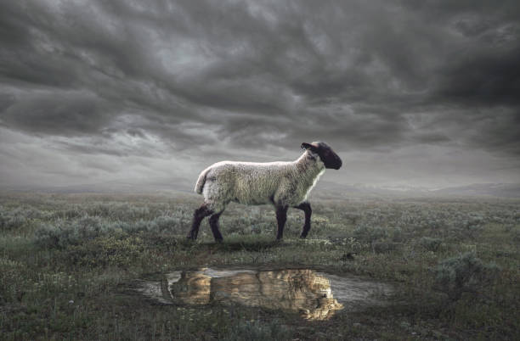
Two Brothers and
A LAMB

Slide 2
In the day when God created man, He made him in the likeness of God. ² He created them male and female, and He blessed them and named them Man in the day when they were created. ³ When Adam had lived one hundred and thirty years, he became the father of a son in his own likeness, according to his image, and named him Seth. (Gen. 5:1-3)

Slide 3
Then the LORD God said, "Behold, the man has become like one of Us, knowing good and evil; and now, he might stretch out his hand, and take also from the tree of life, and eat, and live forever ” ²³ therefore the LORD God sent him out from the garden of Eden, to cultivate the ground from

Slide 4
which he was taken. ²⁴ So He drove the man out; and at the east of the garden of Eden He stationed the cherubim and the flaming sword which turned every direction to guard the way to the tree of life. (Gen. 3:22-24)

Slide 5
Then he showed me a river of the water of life, clear as crystal, coming from the throne of God and of the Lamb, ² in the middle of its street. On either side of the river was the tree of life, bearing twelve kinds of fruit, yielding its fruit every month; and the leaves of the tree were for the healing of the nations. (Rev. 22:1-2)

Slide 6
Now the man had relations with his wife Eve, and she conceived and gave birth to Cain, and she said, "I have gotten a manchild with the help of the LORD." ² Again, she gave birth to his brother Abel. And Abel was a keeper of flocks, but Cain was a tiller of the ground.

Slide 7
³ So it came about in the course of time that Cain brought an offering to the LORD of the fruit of the ground. ⁴ Abel, on his part also brought of the firstlings of his flock and of their fat portions. And the LORD had regard for Abel and for his offering; ⁵ but for Cain and for his offering He had no regard.

Slide 8
So Cain became very angry and his countenance fell. ⁶ Then the LORD said to Cain, "Why are you angry? And why has your countenance fallen? ⁷ "If you do well, will not your countenance be lifted up? And if you do not do well, sin is crouching at the door; and its desire is for you, but you must master it."

Slide 9
⁸ Cain told Abel his brother. And it came about when they were in the field, that Cain rose up against Abel his brother and killed him.

Slide 10
⁹ Then the LORD said to Cain, "Where is Abel your brother?" And he said, "I do not know. Am I my brother's keeper?"¹⁰ He said, "What have you done? The voice of your brother's blood is crying to Me from the ground. ¹¹ "Now you are cursed from the ground, which has opened its mouth to receive your brother's blood from your hand.

Slide 11
¹² "When you cultivate the ground, it will no longer yield its strength to you; you will be a vagrant and a wanderer on the earth." ¹³ Cain said to the LORD, "My punishment is too great to bear!

Slide 12
¹⁴ "Behold, You have driven me this day from the face of the ground; and from Your face I will be hidden, and I will be a vagrant and a wanderer on the earth, and whoever finds me will kill me."

Slide 13
¹⁵ So the LORD said to him, "Therefore whoever kills Cain, vengeance will be taken on him sevenfold." And the LORD appointed a sign for Cain, so that no one finding him would slay him. ¹⁶ Then Cain went out from the presence of the LORD, and settled in the land of Nod, east of Eden. (Gen. 4:1-16)

Slide 14
1. Painful experiences can bring positive results.
“With the Help of the Lord I have brought forth [acquired] a man” (4:1)

Slide 15
1. Painful experiences can bring positive results.
“With the Help of the Lord I have brought forth [acquired] a man” (4:1)
"God has appointed me another offspring in place of Abel, for Cain killed him." (4:25)

Slide 16
1. Painful experiences can bring positive results.
Pain is often God’s instrument to reveal who we are and what we need.

Slide 17
“We can ignore even pleasure. But pain insists upon being attended to. God whispers to us in our pleasures, speaks in our conscience, but shouts in our pains: it is His megaphone to rouse a deaf world....

Slide 18
No doubt pain as God's megaphone is a terrible instrument; it may lead to final and unrepented rebellion. But it gives the only opportunity the bad man can have for amendment. It removes the veil; it plants the flag of truth within the fortress of the rebel soul.”- C.S. Lewis

Slide 19
2. Our Attitudes are an Indicator of our Heart
And the LORD had regard for Abel and for his offering; but for Cain and for his offering He had no regard. So, Cain became very angry and his countenance fell.

Slide 20
2. Our Attitudes are an Indicator of our Heart
⁶ Then the LORD said to Cain, "Why are you angry? And why has your countenance fallen? ⁷ "If you do well, will not your countenance be lifted up? And if you do not do well, sin is crouching at the door; and its desire is for you, but you must master it."

Slide 21
2. Our Attitudes are an Indicator of our Heart
“God not only objects but abhors the sacrifices of the wicked, however splendid they may appear in the eyes of men.” – J Calvin

Slide 22
2. Our Attitudes are an Indicator of our Heart
And it came about when they were in the field, that Cain rose up against Abel his brother and killed him.

Slide 23
“For this reason also the wisdom of God said, ‘I will send to them prophets and apostles, and some of them they will kill and some they will persecute, so that the blood of all the prophets, shed since the foundation of the world, may be charged against this generation, from the blood of Abel to the blood of Zechariah (Luke 11:49-51)

Slide 24
2. Our Attitudes are an Indicator of our Heart
“Of Him all the prophets bear witness that through His name everyone who believes in Him receives forgiveness of sins.” (Act 10:43)

Slide 25
3. God’s Mercy is Wider than our Expectation
Cain said to the LORD, "My punishment is too great to bear!

Slide 26
He said, "What have you done? The voice of your brother's blood is crying to Me from the ground. "Now you are cursed from the ground, which has opened its mouth to receive your brother's blood from your hand. "When you cultivate the ground, it will no longer yield its strength to you; you will be a vagrant and a wanderer on the earth." (Gen. 4:10-12)

Slide 27
3. God’s Mercy is Wider than our Expectation
Cain said to the LORD, "My punishment is too great to bear!

Slide 28
"Behold, You have driven me this day from the face of the ground; and from Your face I will be hidden, and I will be a vagrant and a wanderer on the earth, and whoever finds me will kill me."

Slide 29
So the LORD said to him, "Therefore whoever kills Cain, vengeance will be taken on him sevenfold." And the LORD appointed a sign for Cain, so that no one finding him would slay him. (Gen. 4:14-15)

Slide 30
3. God’s Mercy is Wider than our Expectation
Or do you think lightly of the riches of His kindness and tolerance and patience, not knowing that the kindness of God leads you to repentance? (Rom. 2:4)

Slide 31
"God's love is an exercise of his goodness toward sinners. As such, it has the nature of grace and mercy. It is an outgoing of God in kindness which not merely is undeserved but is actually contrary to what we deserve; for the objects of God's love are rational creatures who have broken God's law, whose nature is corrupt in God's sight, and who merit only condemnation and final banishment from his presence." – J.I. Packer

Slide 32
Where are you today?

